Slide 1
COMMUNITY SERVICE DURING CORONA(COVID-19) OUTBREAK

Slide 2
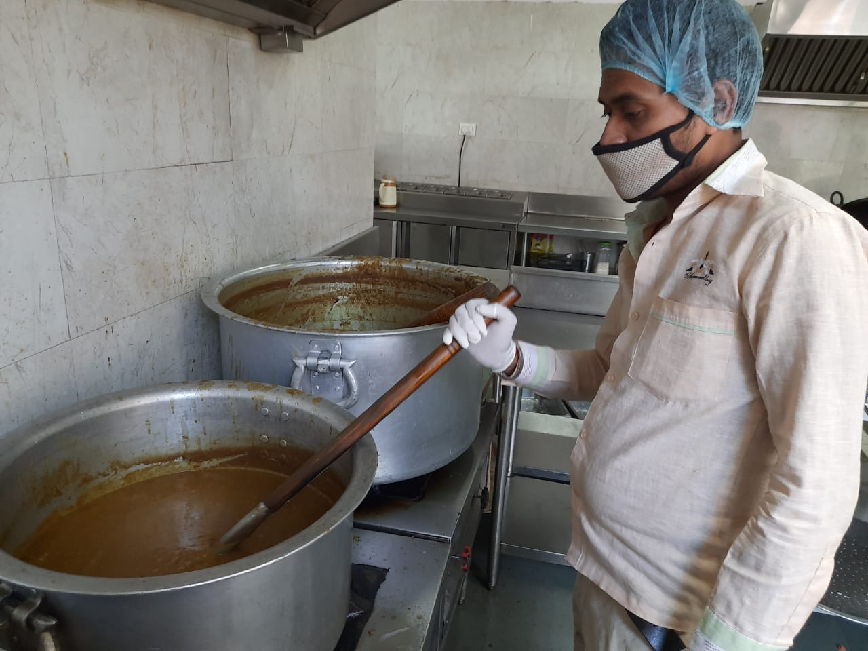
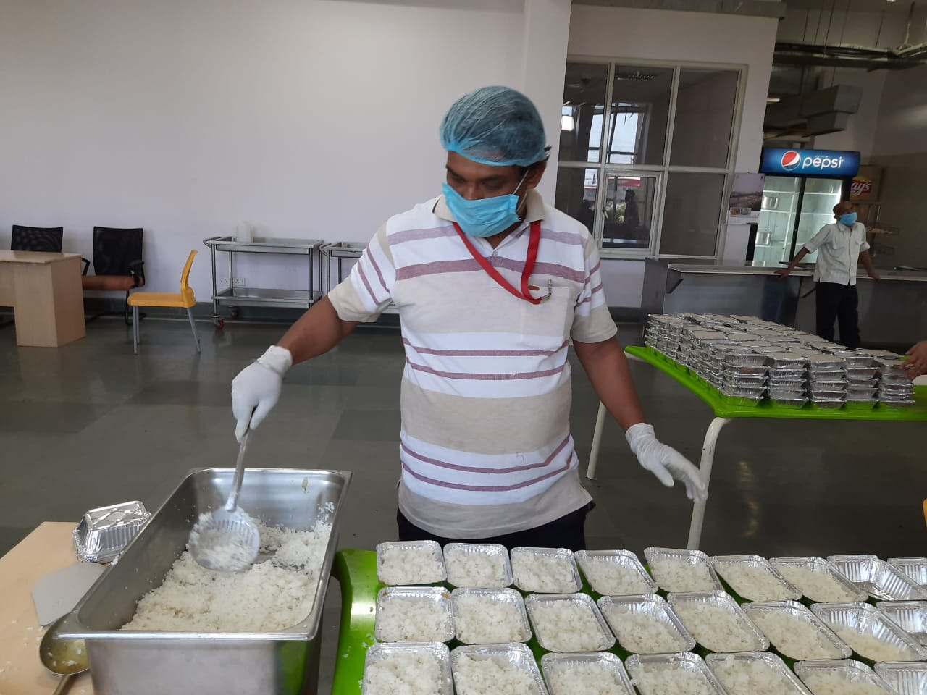
lucknow: Community Kitchen set up by upmrc at transport nagar metro depot

Slide 3
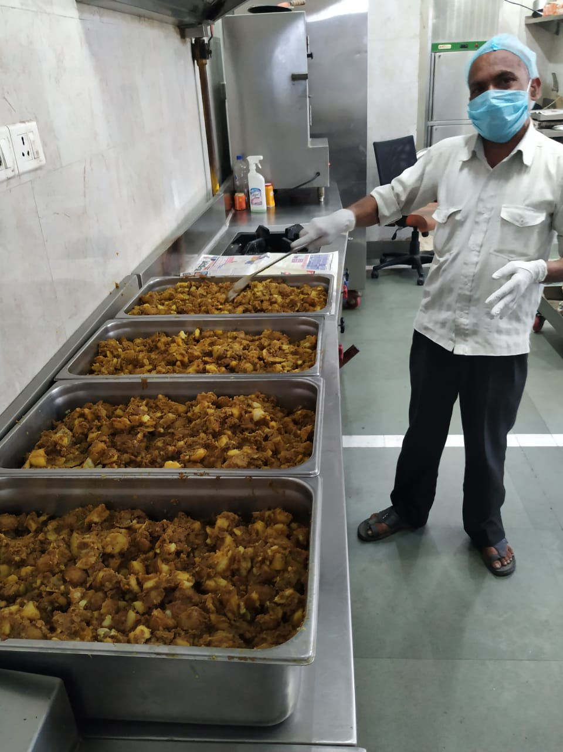
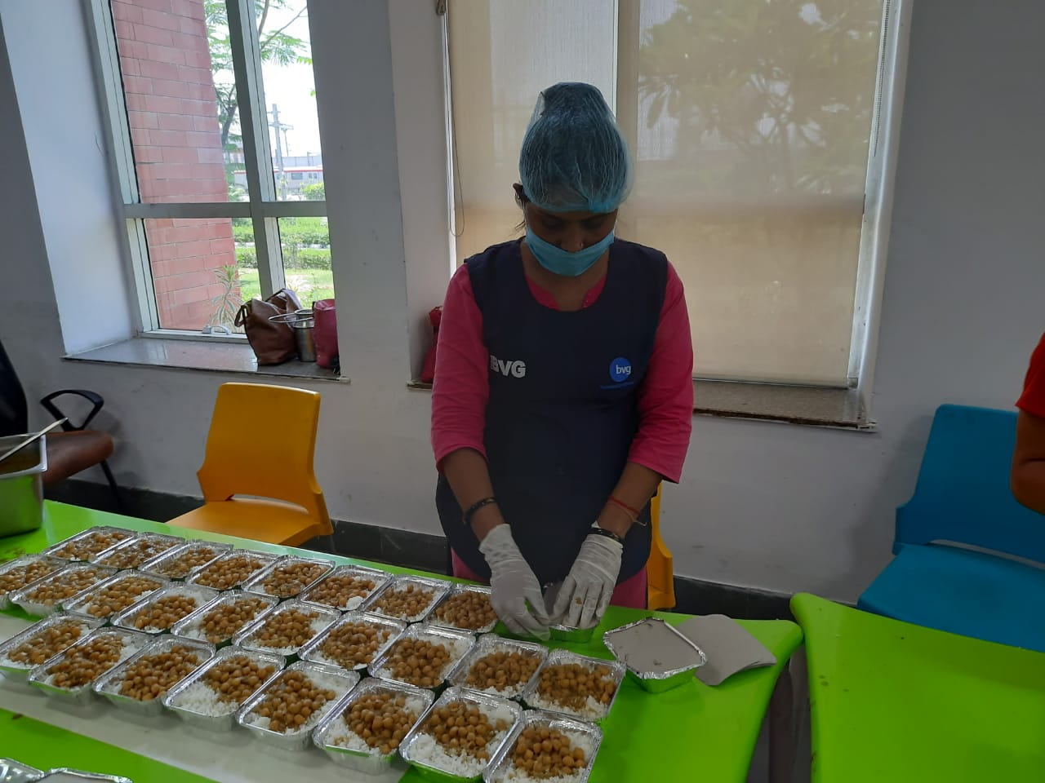
LUCKNOW: Food packets being prepared and packaged at transport nagar depot canteen

Slide 4
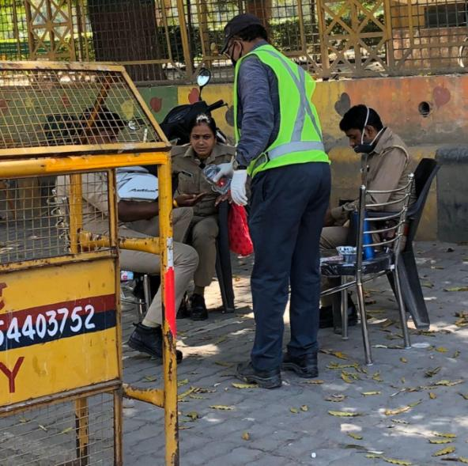
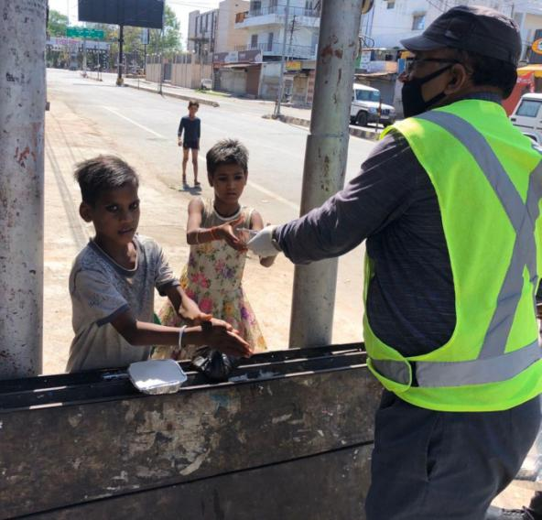
Kanpur: SERVING FOOD PACKETS,HAND SANITIZER & FACE MASK TO THE POLICE PERSONNEL & LOCAL PEOPLE near MOTIJHEEL

Slide 5
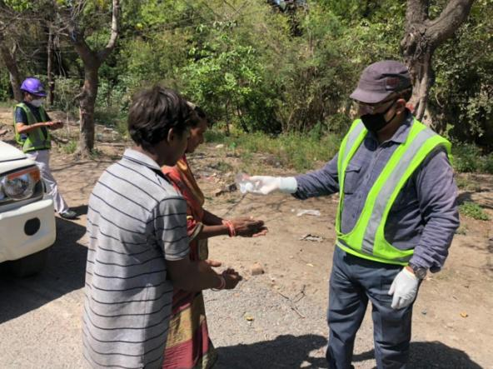
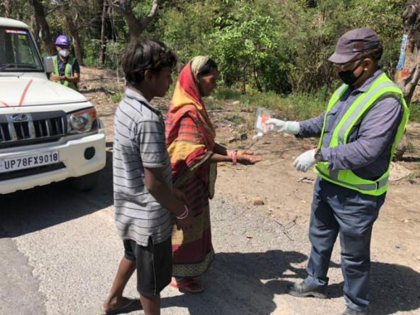
Kanpur: SERVING FOOD PACKETS,HAND SANITIZER & FACE MASK TO THE LOCAL PEOPLE NEAR GEETA NAGAR

Slide 6
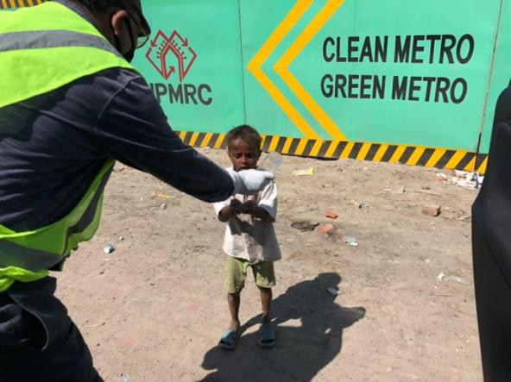
Kanpur: SERVING NEEDY AND UNDERPRIVILEGED NEARBY THE METRO PROJECT AREA

